Slide 1
Chapter 3
E-business Infrastructure

Slide 2
Learning outcomes
Outline the hardware and software technologies used to build an e-business infrastructure within an organisation and with its partners
Outline the hardware and software requirements necessary to enable employee access to the Internet and hosting of
e-commerce services.

Slide 3
Management issues
What are the practical risks to the organization of failure to manage e-commerce infrastructure adequately?
How should staff access to the Internet
be managed?

Slide 4
Why the jargon?
Why do business managers need to know about the jargon and technology?

Slide 5
Activity 3.1 Infrastructure issues
Make a list of the potential problems for users of e-business services developed by The B2C Company.
You should consider problems faced by users of e-business applications who are both internal and external to the organization.
Base your answer on problems you have experienced on a web site that can be related to network, hardware and software failures or problems with data quality.

Slide 6
Typical problems
Web site communications too slow.
Web site not available.
Bugs on site through pages being unavailable or information typed in forms not being executed.
Ordered products not delivered on time.
E-mails not replied to.
Customers’ privacy or trust is broken through security problems such as credit cards being stolen or addresses sold to other companies.

Slide 7
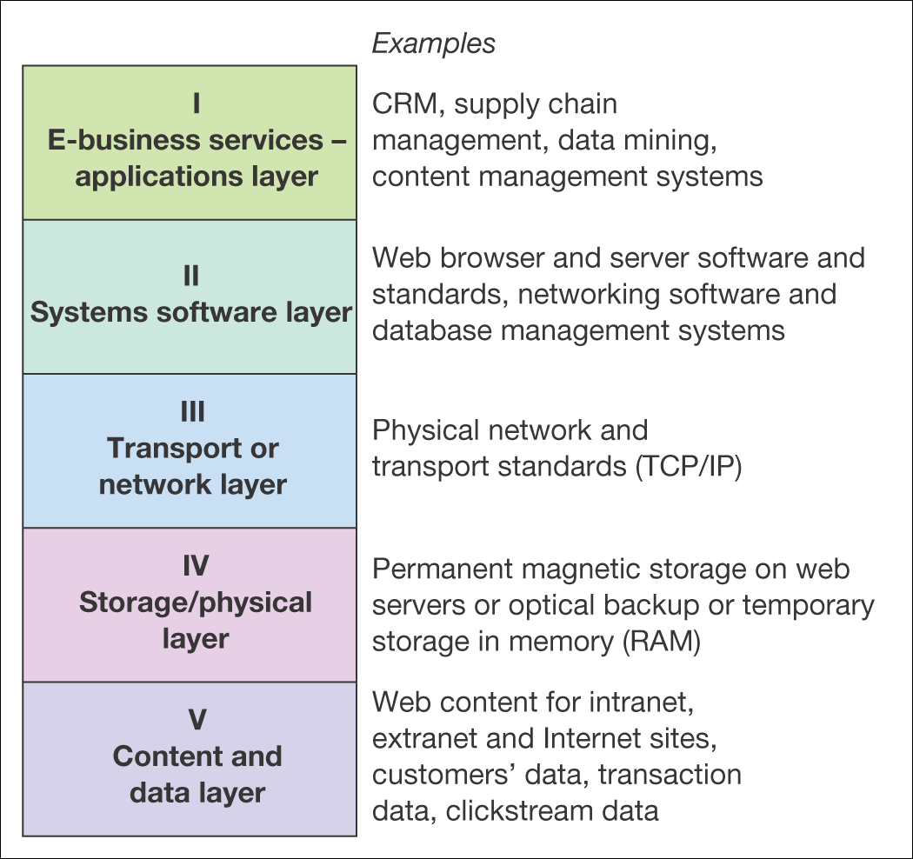
Figure 3.1 A five-layer model of e-business infrastructure

Slide 8
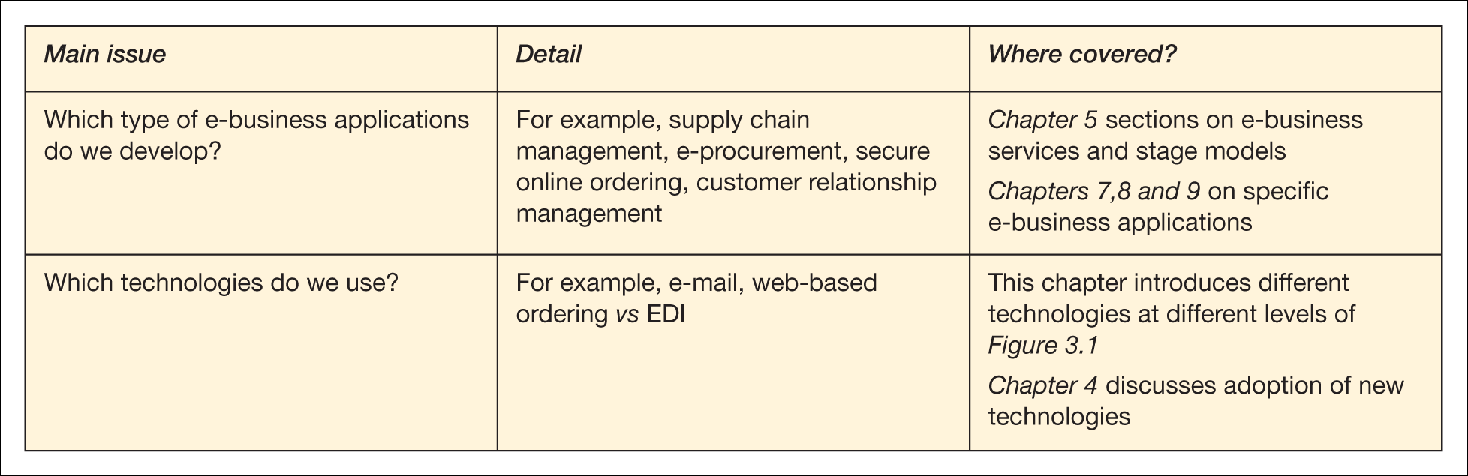
Table 3.1 Key management issues of e-business infrastructure

Slide 9
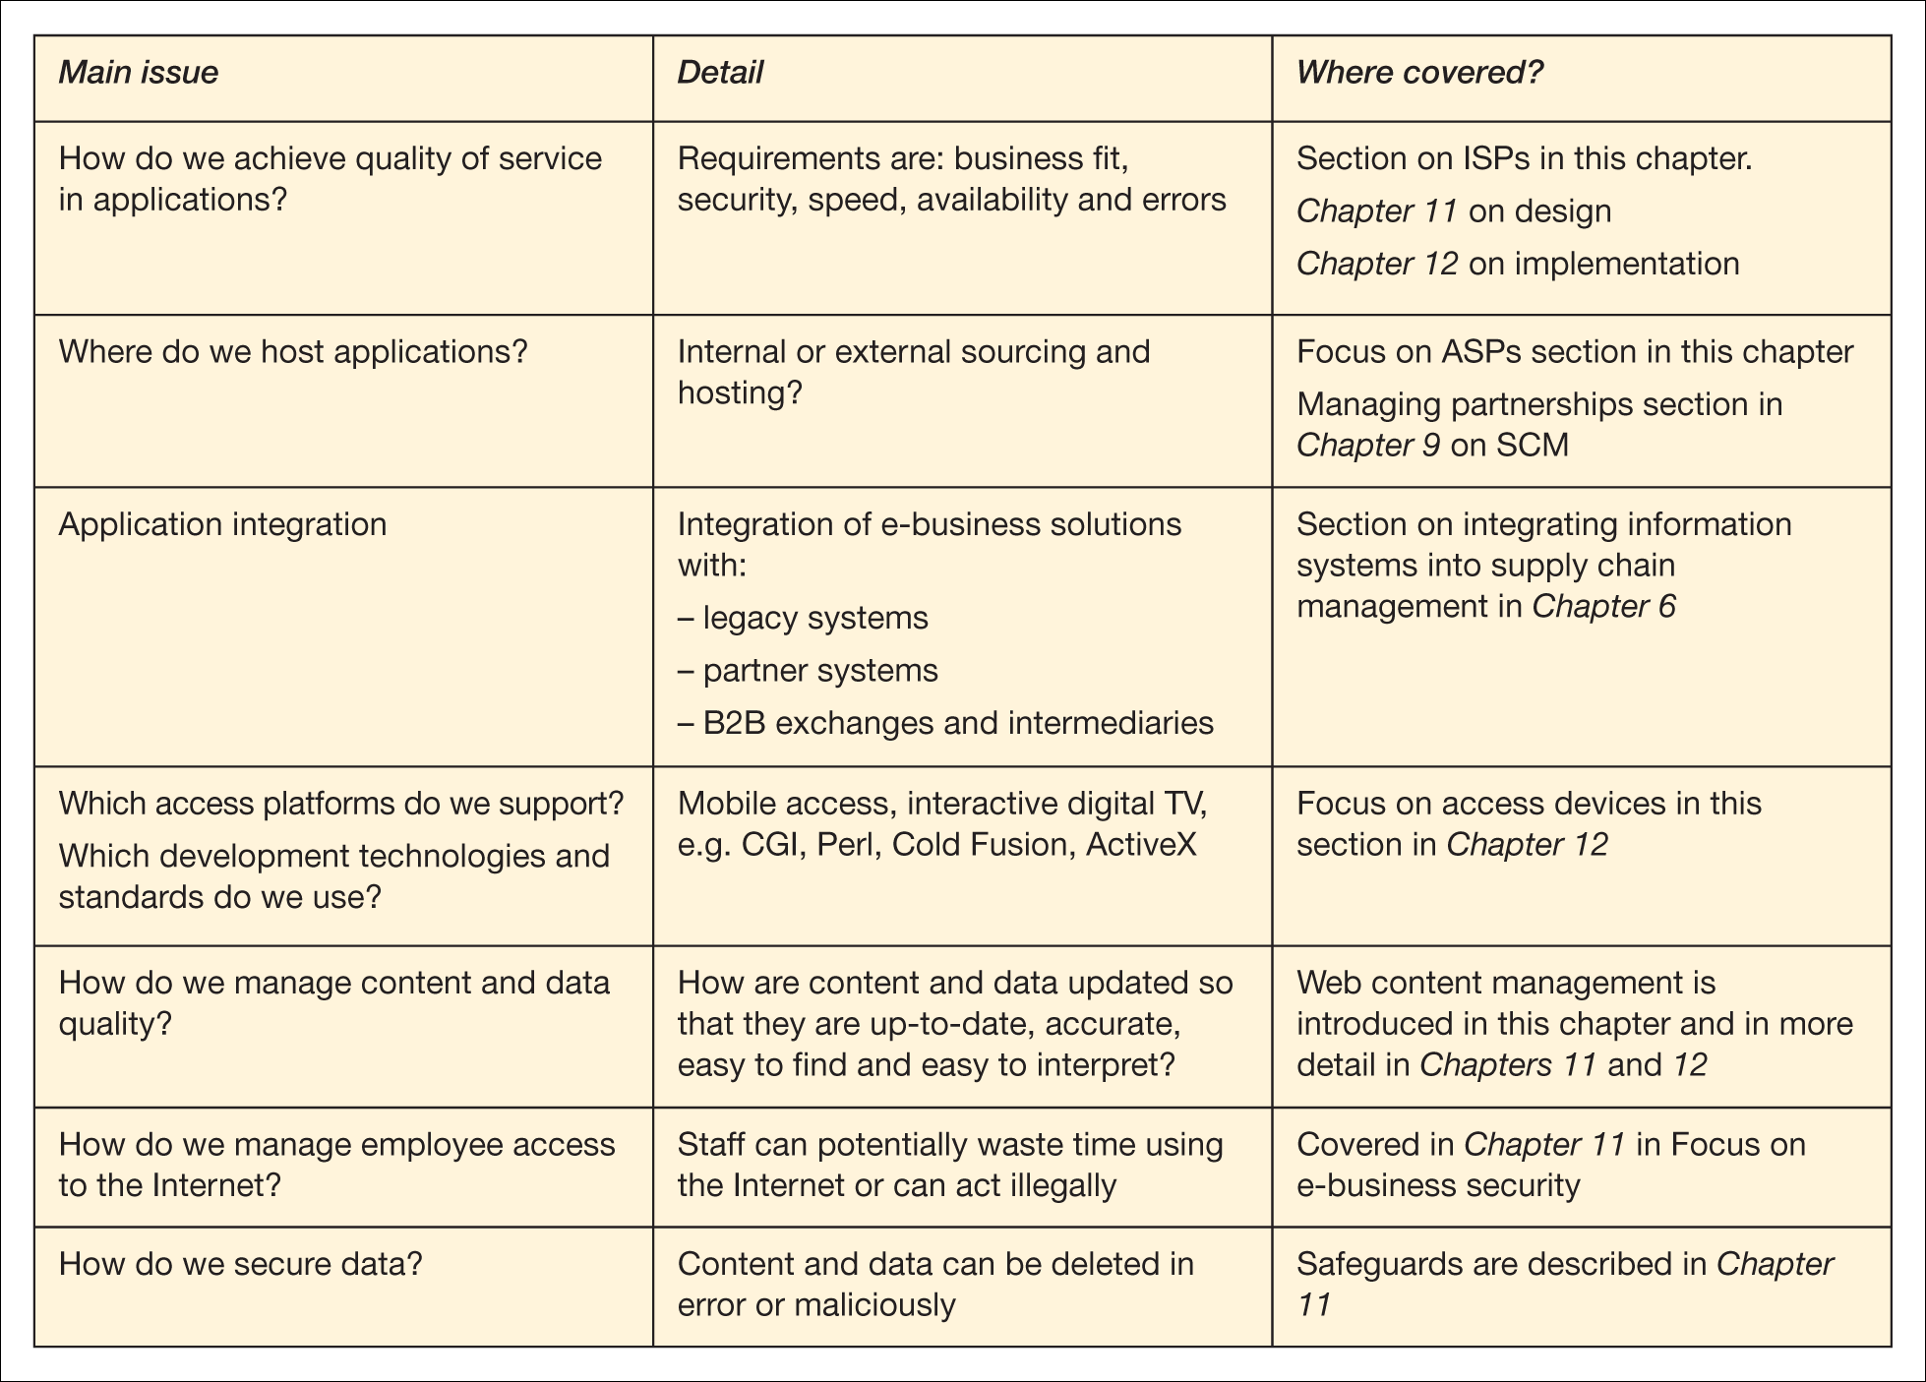
Table 3.1 Key management issues of e-business infrastructure (Continued)

Slide 10
Activity – Internet infrastructure components
Write down all the different types of hardware and software involved from when a user types in a web address such as www.google.com to the web site being loaded.

Slide 11
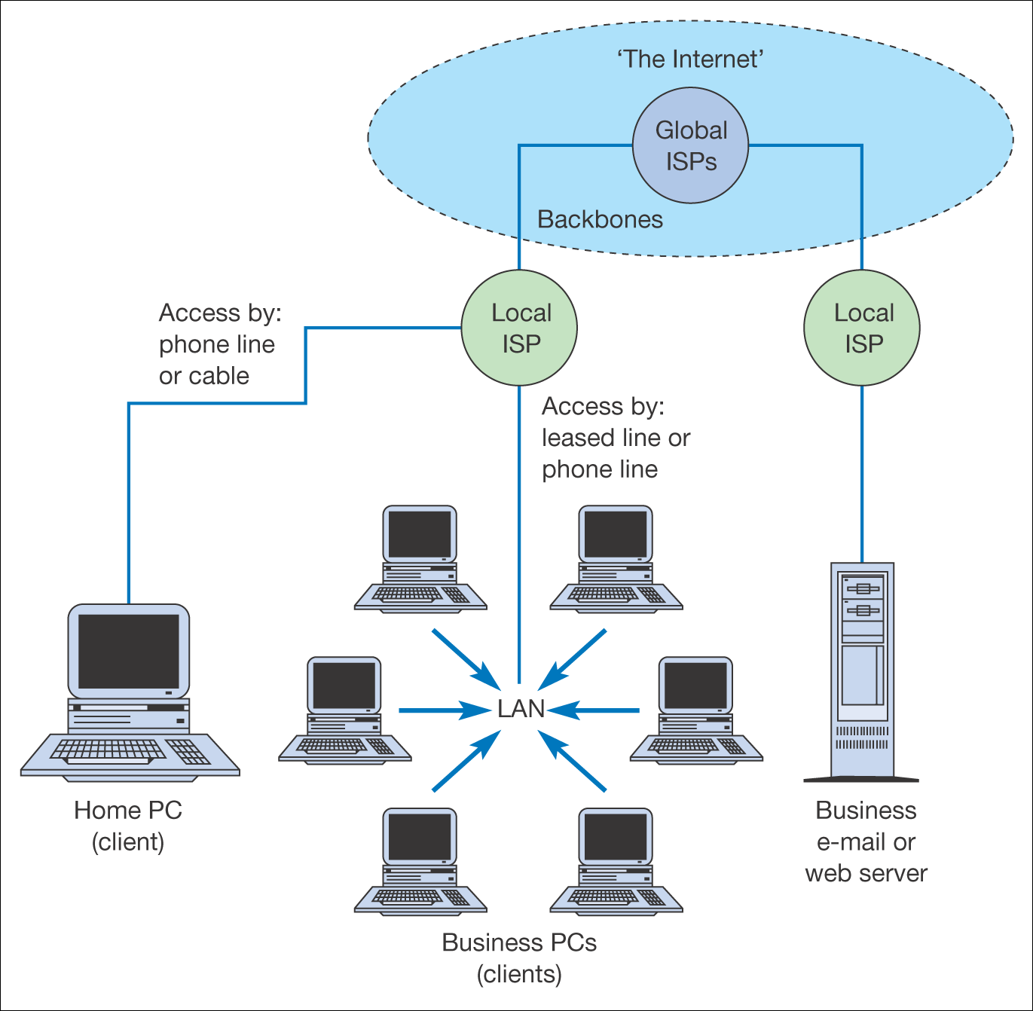
Figure 3.2 Physical and network infrastructure components of the Internet
(Levels IV and III in Figure 3.1)

Slide 12
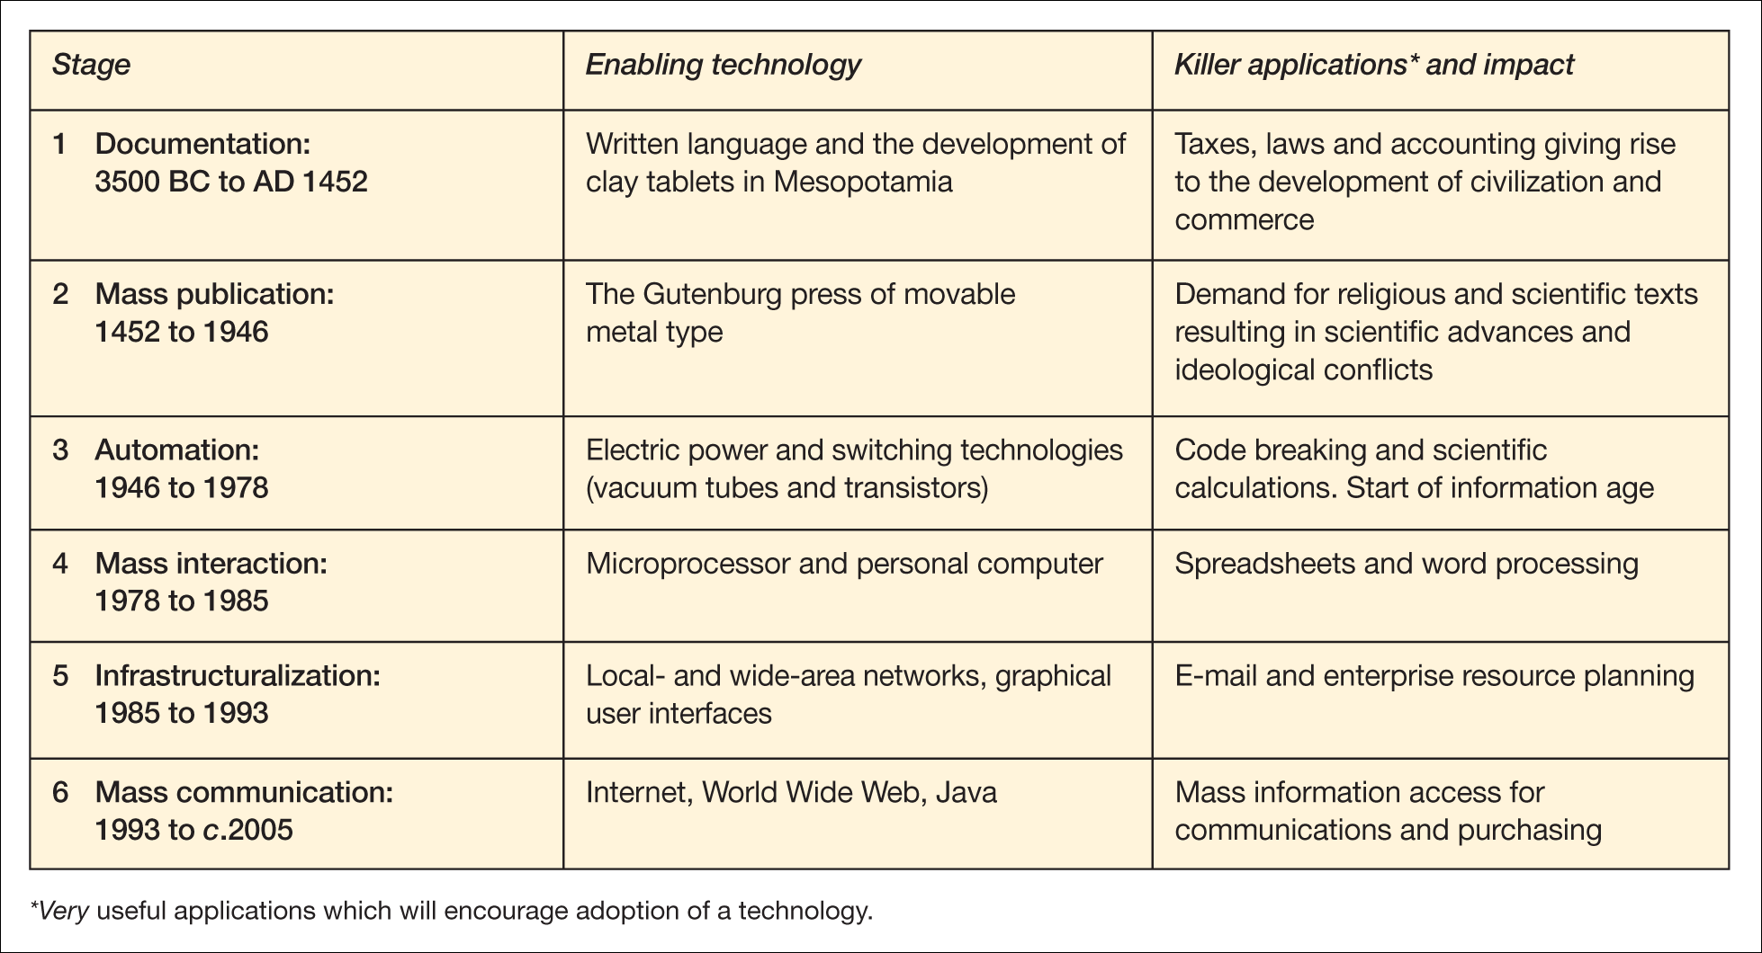
Table 3.2 Six stages of advances in the dissemination of information

Slide 13
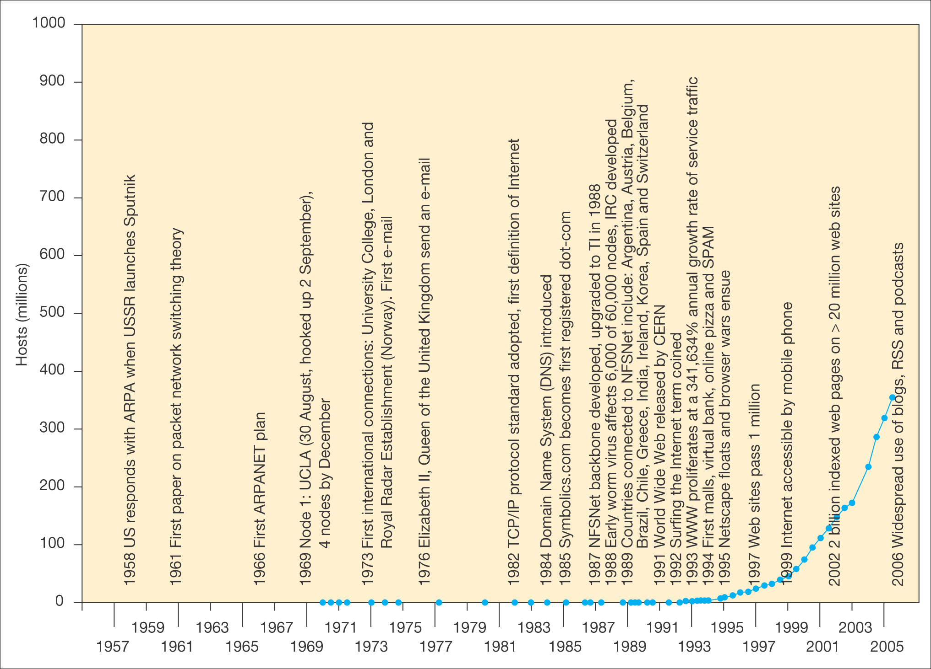
Figure 3.3 A five-layer model of e-business infrastructure

Slide 14
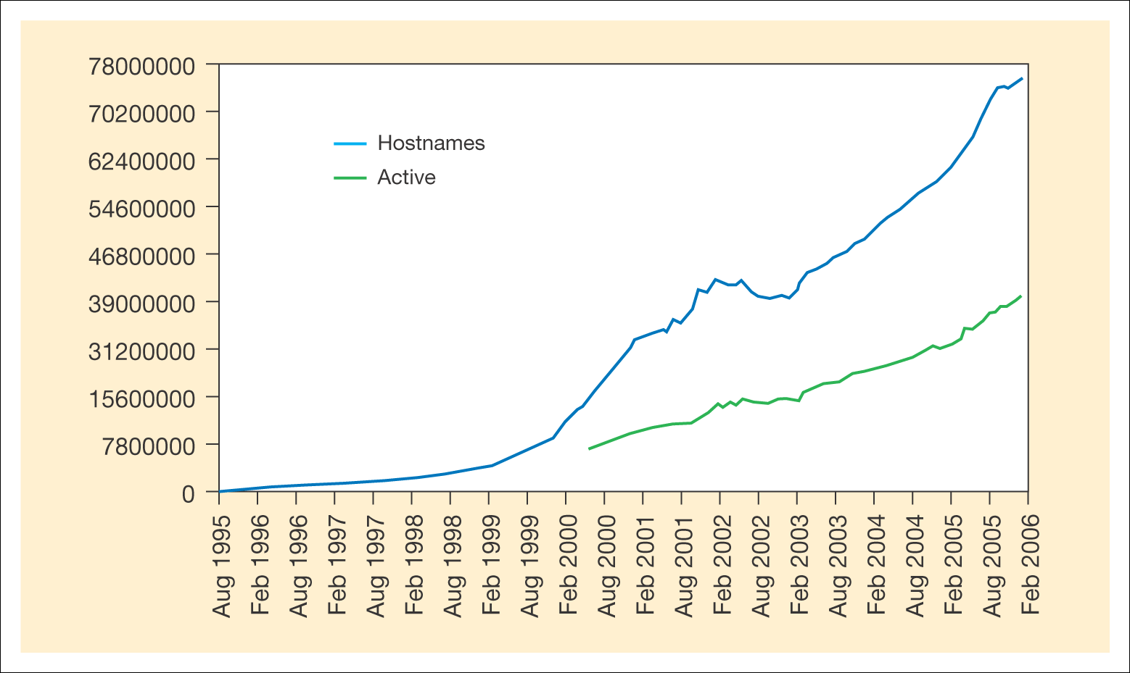
Figure 3.4 The Netcraft index of number of servers
Source: Netcraft Web Server Survey. http://news.netcraft.com/archives/web server survey.html. Netcraft, http://netcraft.com

Slide 15
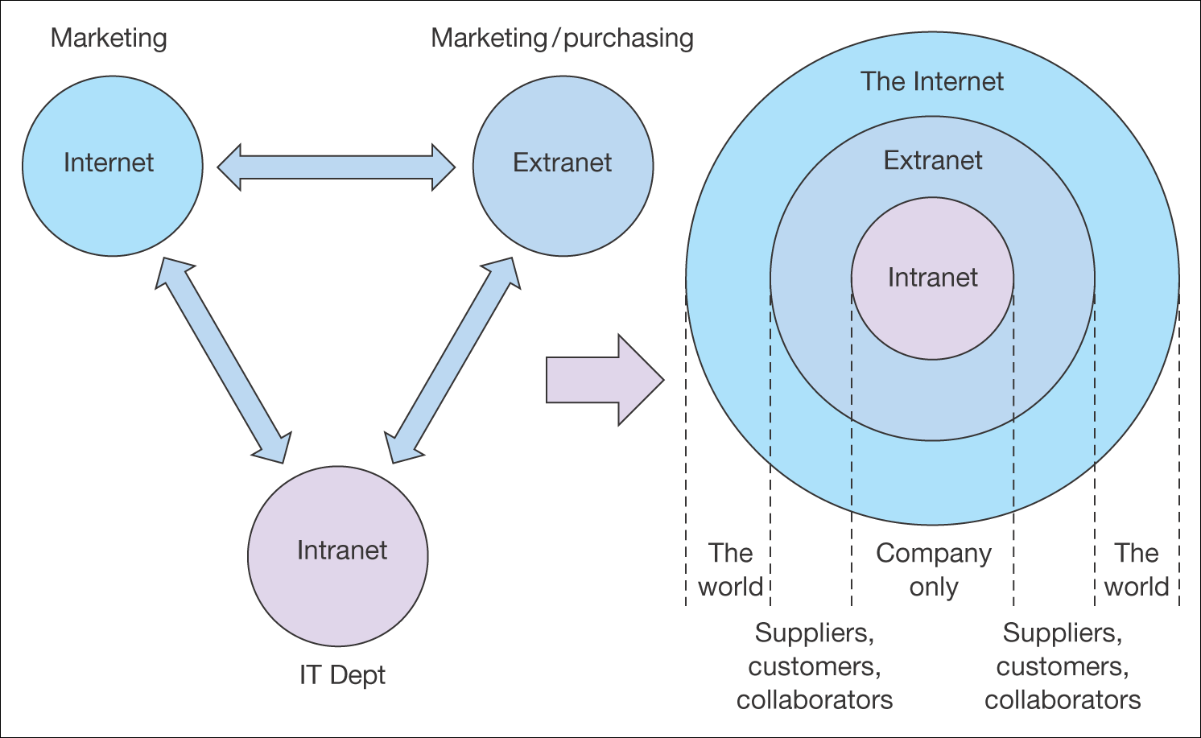
Figure 3.5 The relationship between intranets, extranets and the Internet

Slide 16
Activity – a common problem with intranets and extranets
The B2B Company has found that after an initial surge of interest in its intranet and extranet, usage has declined dramatically. Many of the warning signs mentioned in the KM (2002) article listed above are evident. The e-business manager wants to achieve these aims:
1. Increase usage.
2. Produce more dynamic content.
3. Encouraging more clients to order (extranet).
What would you suggest?

Slide 17
Suggested answer
Identify benefits
Involve staff with development
Find system sponsors, owners and advocates
Train on benefits
Keep content fresh, relevant and where possible, fun
Use e-mail to encourage usage.

Slide 18
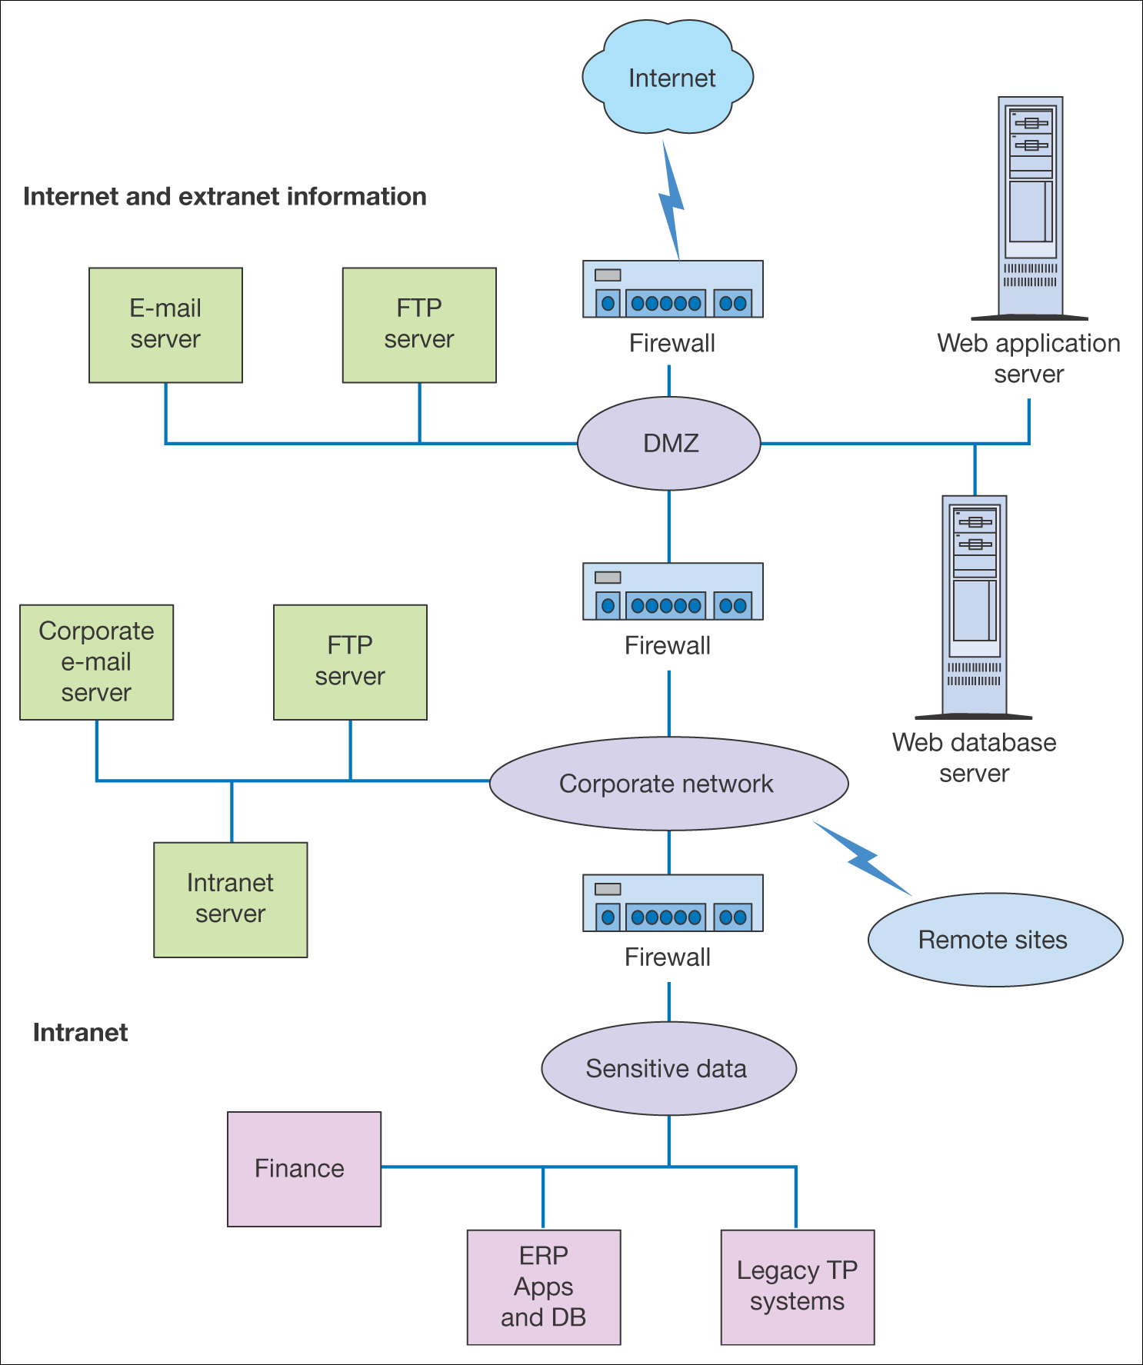
Figure 3.6 Firewall positions within the e-business infrastructure of the
B2B company

Slide 19
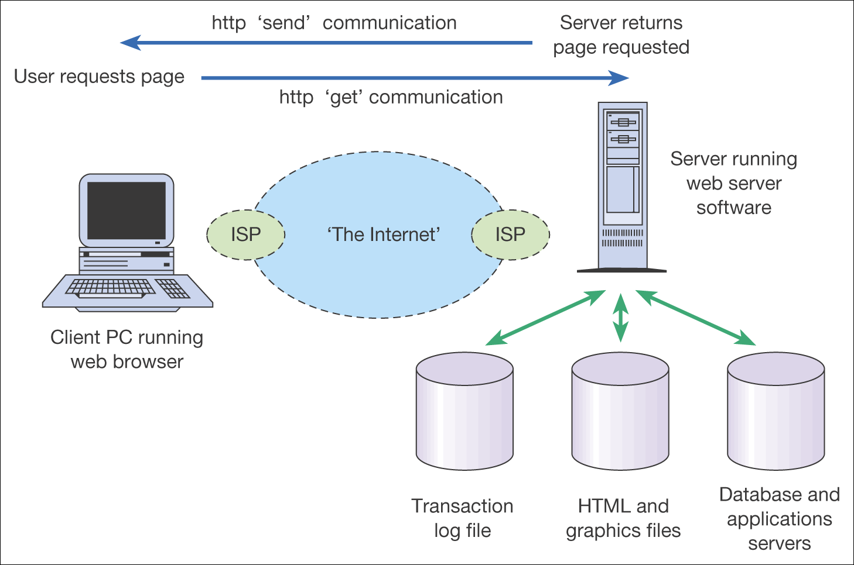
Figure 3.7 Information exchange between a web browser and web server

Slide 20
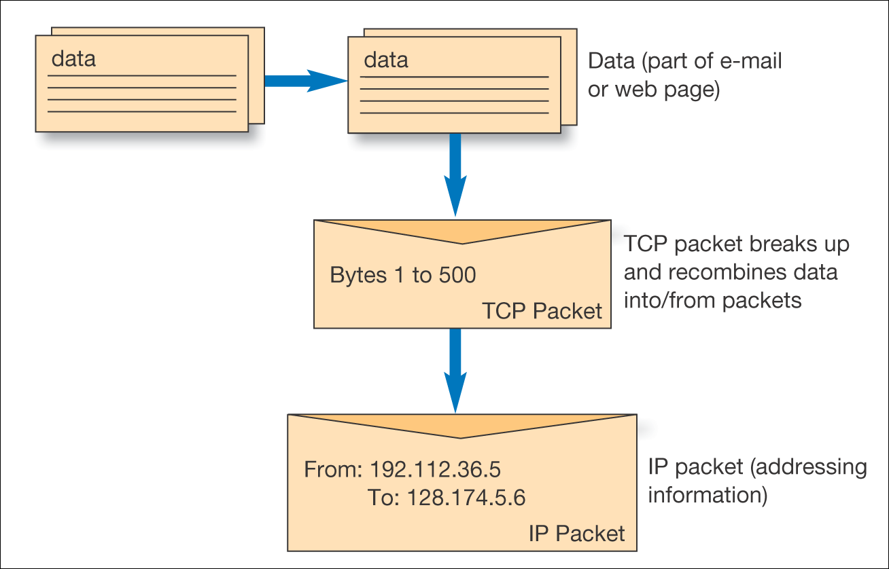
Figure 3.8 The TCP/IP protocol

Slide 21
URLS and domain names
Web addresses are structured in a standard way as follows:
http://www.domain-name.extension/filename.html
What do the following extensions or global top level domains stand for?
  .com
  .co.uk, .uk.com
  .org or .org.uk
  .gov
  .edu, .ac.uk
  .int
  .net
  .biz
  .info

Slide 22
HTML and XML
HTML (Hypertext Markup Language)
A standard format used to define the text and layout of web pages. HTML files usually have the extension .HTML or .HTM.
XML or eXtensible Markup Language
A standard for transferring structured data, unlike HTML which is purely presentational.

Slide 23
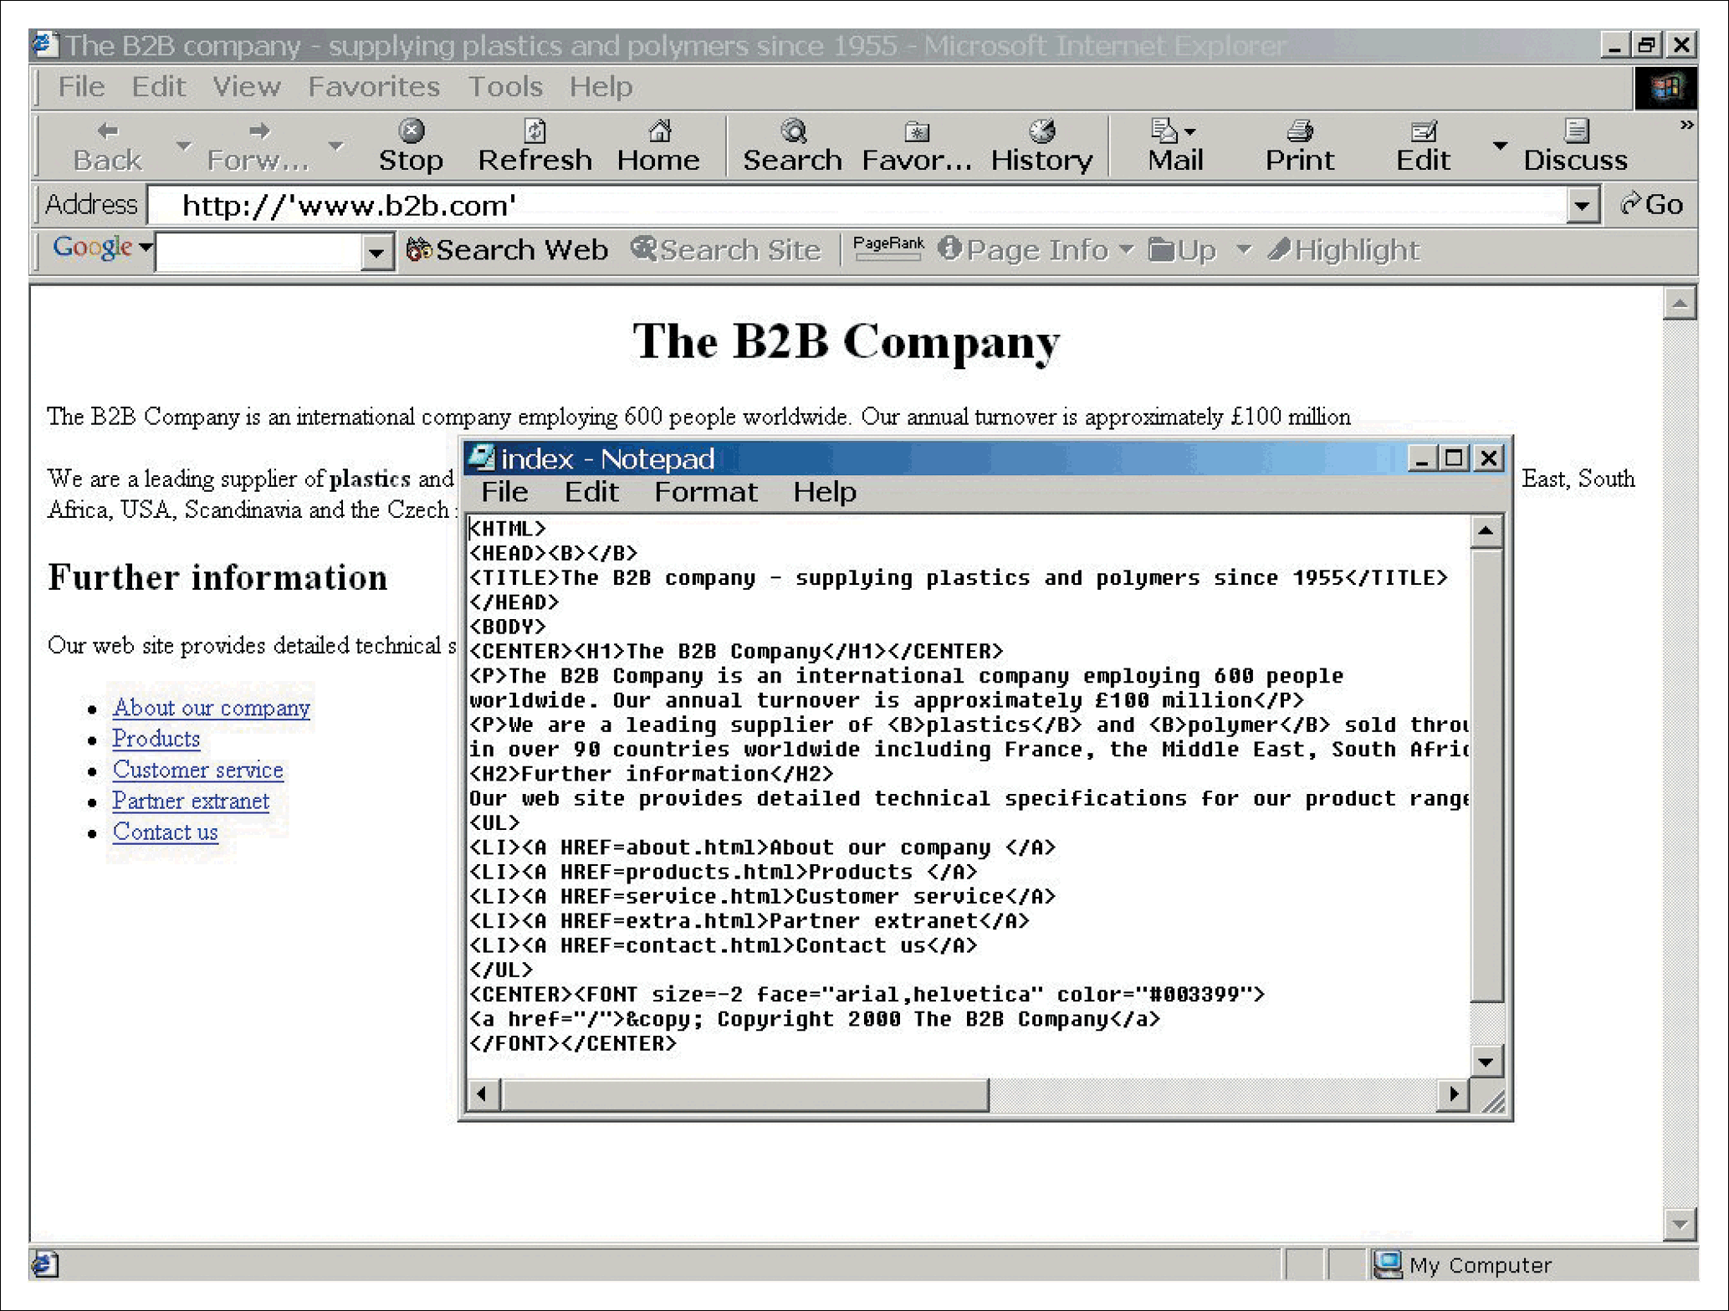
Figure 3.9 Home page index.html for The B2B Company in a web browser showing HTML source in text editor

Slide 24
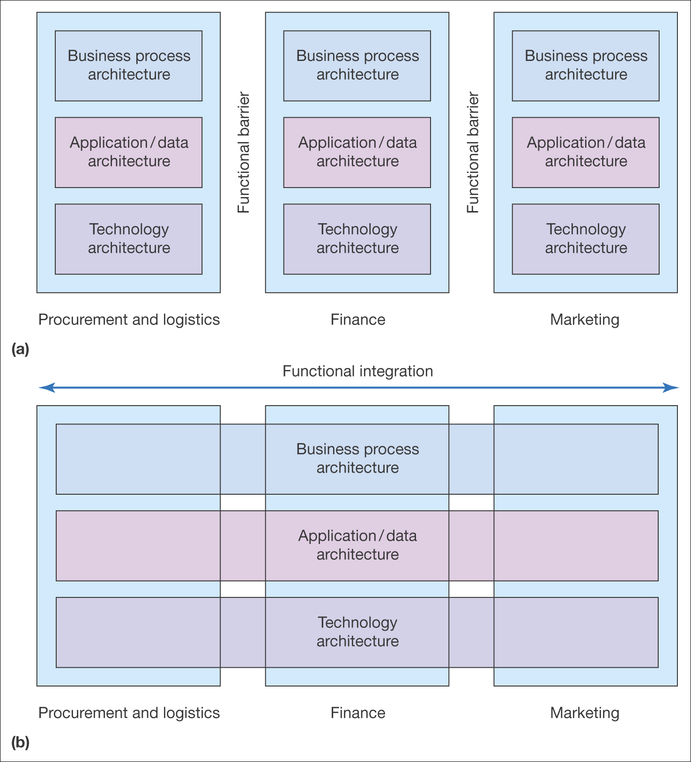
Figure 3.10 (a) Fragmented applications infrastructure, (b) integrated applications infrastructure
Source: Adapted from Hasselbring (2000)

Slide 25
XML example
Product>
<Action Value5”Delete”/>
<ProductID>118003-008</ProductID>
</Product>
<Product Type5”Good” SchemaCategoryRef5”C43171801”>
<ProductID>140141-002</ProductID>
<UOM><UOMCoded>EA</UOMCoded></UOM>
<Manufacturer>Compaq</Manufacturer>
<LeadTime>2</LeadTime>
<CountryOfOrigin>
<Country><CountryCoded>US</CountryCoded></Country>
</CountryOfOrigin>

Slide 26
Media standards
GIF (Graphics Interchange Format) A graphics format and compression algorithm best used for simple graphics
JPEG (Joint Photographics Experts Group) A graphics format and compression algorithm best used for photographs
Streaming media. Sound and video that can be experienced within a web browser before the whole clip is downloaded e.g. Real Networks .rm format
Video standards include MPEG and .AVI
Sound standards include MP3 and WMA

Slide 27
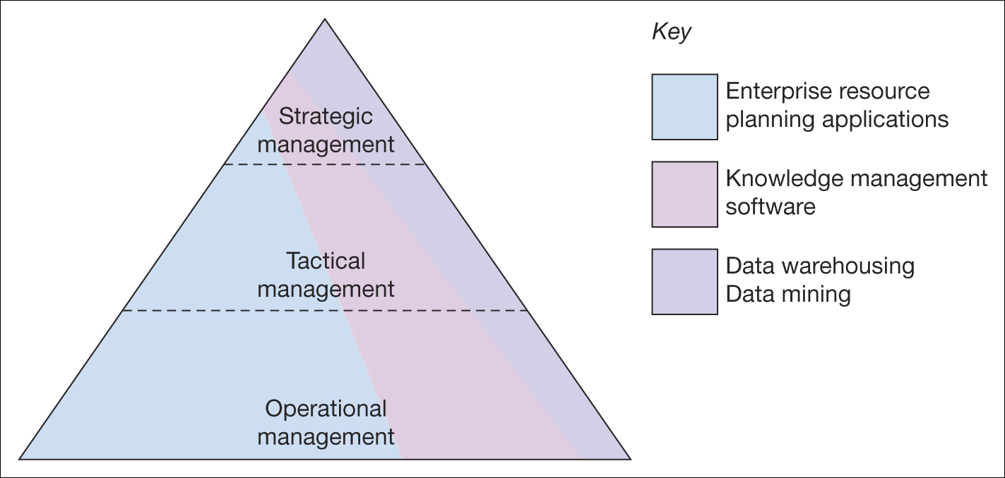
Figure 3.11 Differing use of applications at levels of management within companies

Slide 28
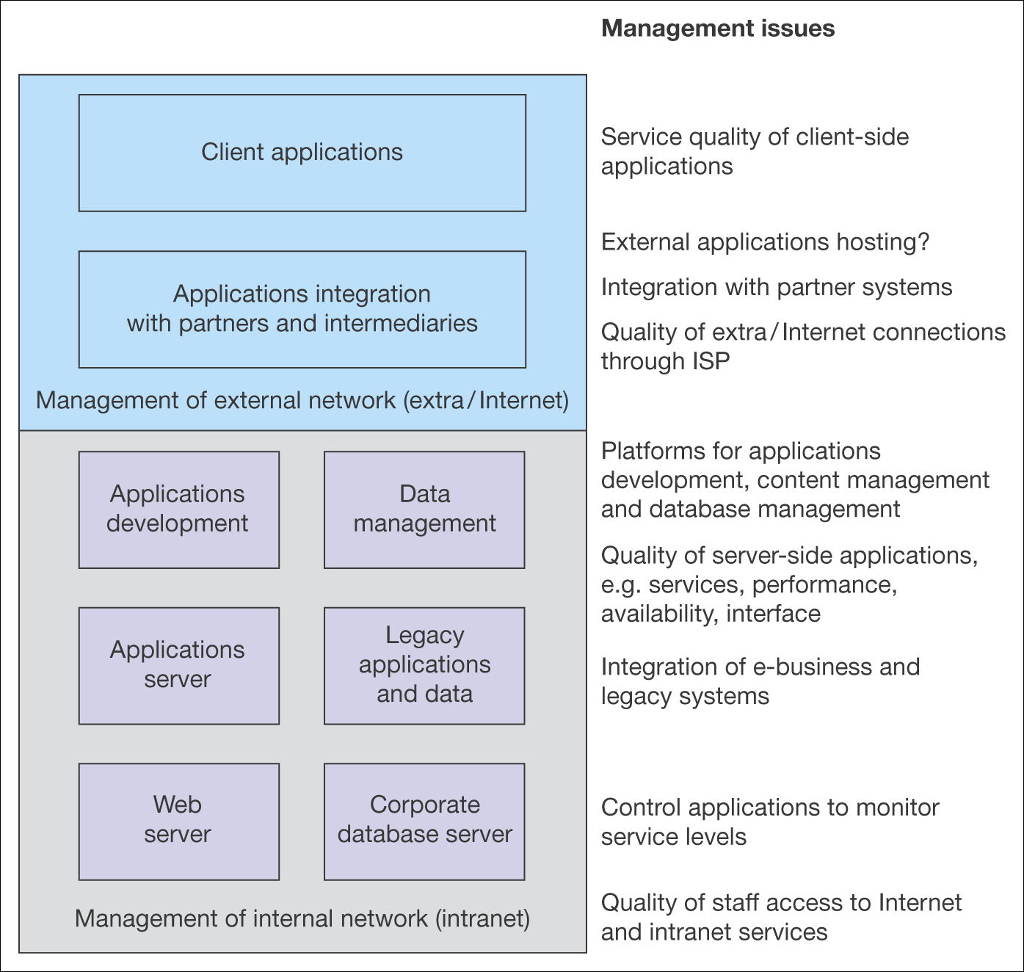
Figure 3.12 Elements of e-business infrastructure that require management

Slide 29
Activity – how would you respond
You are e-commerce manager for the BBC.
How would you evaluate your response to the launch of the 3G phone.
That is which sources would you use to base your response on?

Slide 30
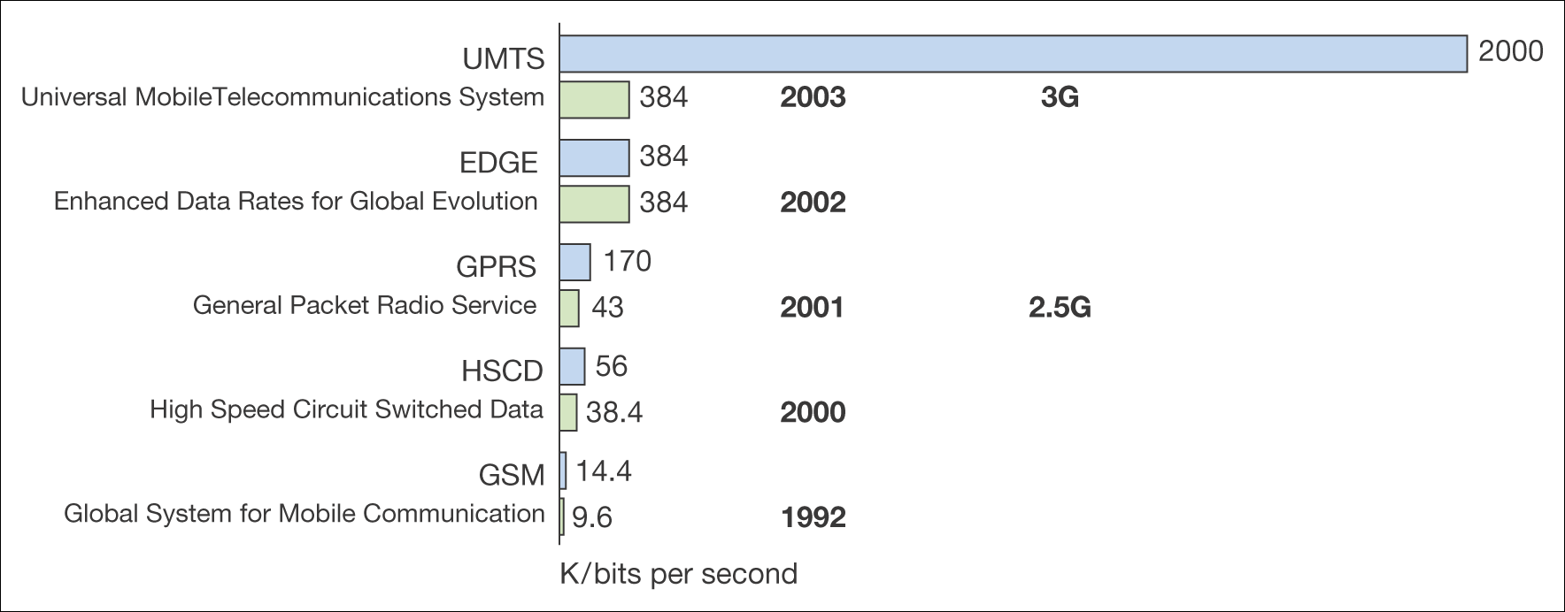
Figure 3.13 Mobile access technologies

Slide 31
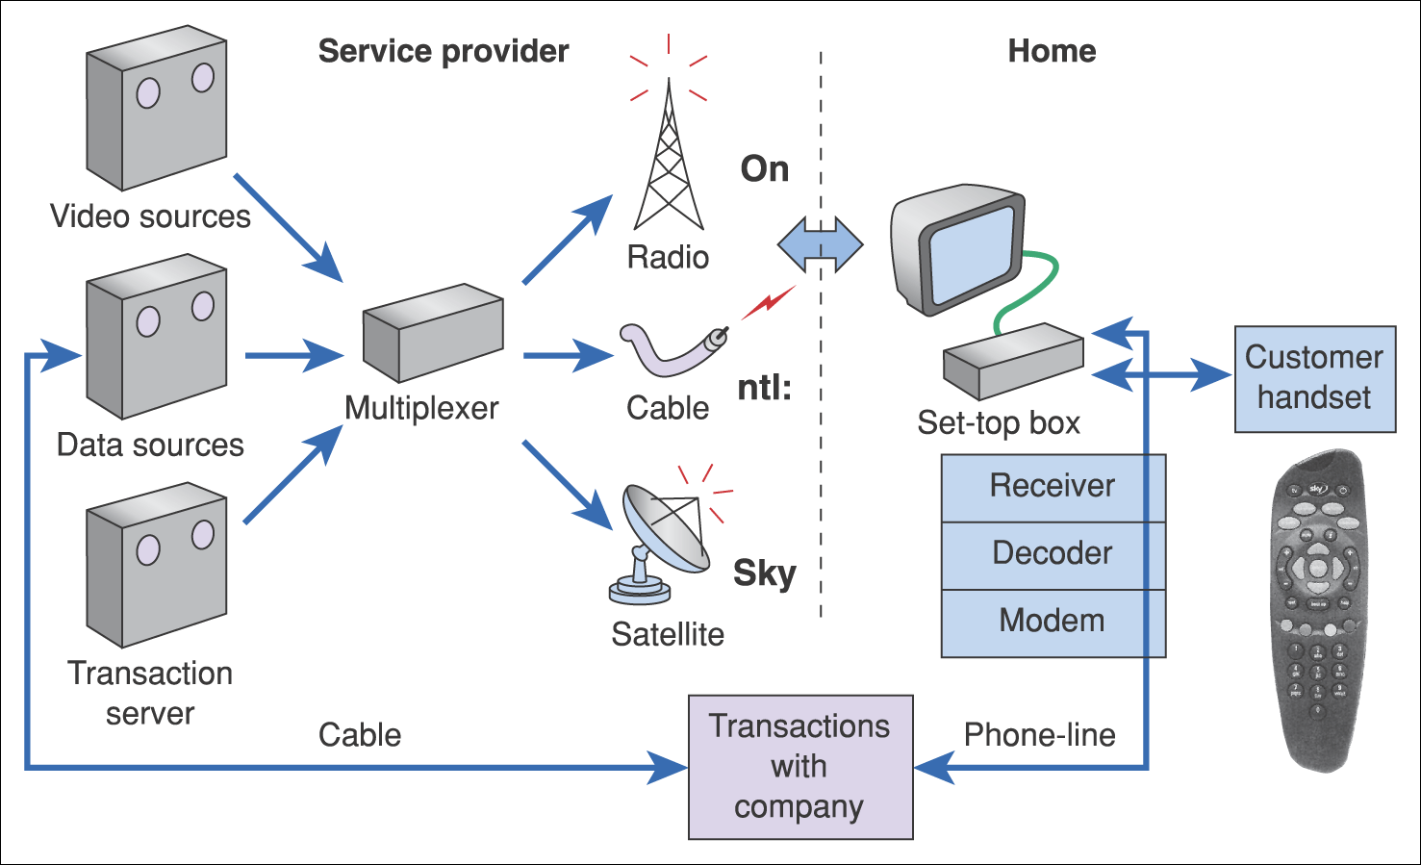
Figure 3.14 Components of an interactive digital TV system

